Slide 1
Mathematical Foundations for Intelligent Systems
Linear algebra- IV

Slide 2
Outline
Latent Semantic Indexing

Slide 3
Latent Semantic Indexing (LSI)
LSI is method for discovering hidden concepts in document data.
LSI allow the user to search for concepts rather than specific words.
LSI can retrieve documents related to a user's query even when the query and the documents do not share any common terms
Each document and term (word) is expressed as a vector with elements corresponding to these concepts.
Each element in a vector gives the degree of participation of the document or term in the corresponding concept.
The goal is to represent the documents and terms in a unified way for exposing document-document, document-term, and term-term similarities or semantic relationship which are otherwise hidden.

Slide 4
Use of SVD in LSI
SVD takes the original data, ( usually a word X document matrix) , and breaks it down into linearly independent components
These components are an abstraction away from the noisy correlations found in the original data
It is the best approximate the underlying structure of the dataset along each dimension independently
It also reduces the dimensionality through representation of items that share substructure become more similar to each other.
The documents about a particular topic become more similar even if the exact same words don't appear in all of them.

Slide 5
Example
d1 : Saleem and Anarkali.
d2 : Anarkali: O happy gun!
d3 : Saleem finished by gun.
d4 : “Live lavishly or finish”, it is the New-Article’s motto.
d5 : Do you know, New-Article?.
and a search query: “
“ finishes, gun”
Clearly, d3 should be ranked top of the list since it contains both for “finishes, gun”
Then, d2 and d4 should follow, each containing a word of the query.

Slide 6
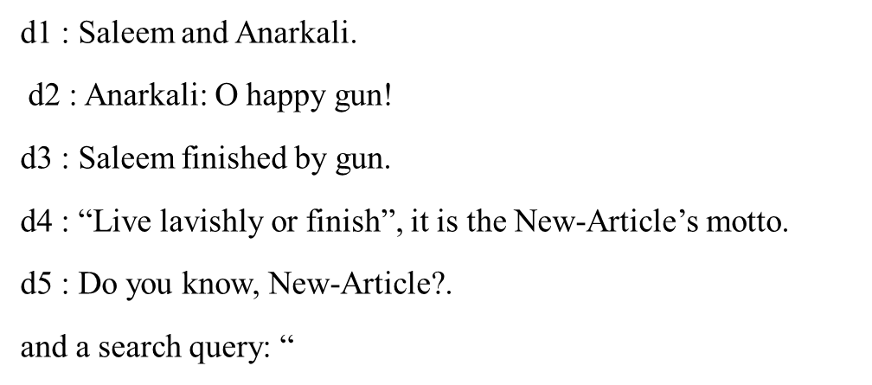
what about d1 and d5?
Should they be returned as possibly interesting results to this query?
As humans we know that d1 is quite related to the query. On the other hand, d5 is not so much related to the query. Thus, we would like d1 but not d5,
we want d1 to be ranked higher than d5.
The question is: Can the machine deduce this?
yes, LSI does exactly that

Slide 7
In this example, LSI will be able to see that term gun is related to d1 because it occurs together with the d1’s terms Saleem and Anarkali, in d2 and d3, respectively.
The term finishes is related to d1 and d5 because it occurs together with the d1’s term Saleem and d5’s term New-Article in d3 and d4, respectively.
LSI will also weigh properly the discovered connections; d1 more is related to the query than d5 since d1 is “doubly” connected to gun through Saleem and Anarkali, and also connected to finishes through Saleem, whereas d5 has only a single connection to the query through New-Article.

Slide 8
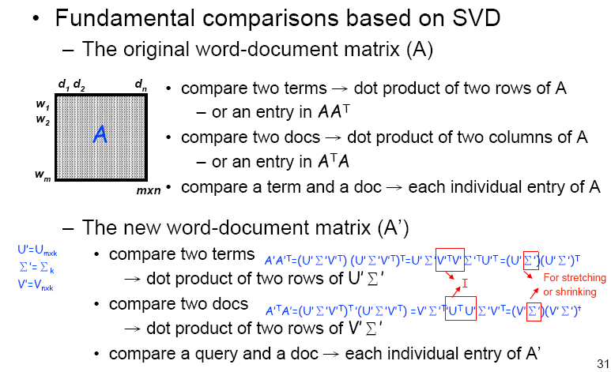
SVD for LSI
Term- document matrix
 | d1 | d2 | d3 | d4 | d5
Saleem | 1 | 0 | 1 | 0 | 0
Anarkali | 1 | 1 | 0 | 0 | 0
happy | 0 | 1 | 0 | 0 | 0
gun | 0 | 1 | 1 | 0 | 0
live | 0 | 0 | 0 | 1 | 0
finishes | 0 | 0 | 1 | 1 | 0
Lavish | 0 | 0 | 0 | 1 | 0
New-article | 0 | 0 | 0 | 1 | 1

Slide 9
Computing Similarity in LSI
Let B = A^{T}A is the document-document matrix.
B[i, j] = b , if documents i and j have b words in common.
C = AA^{T} is the term-term matrix.
C[i, j] = c ,if terms i and j occur together in c documents

Slide 10
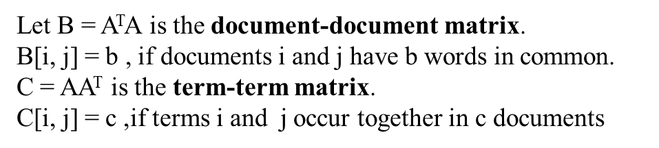

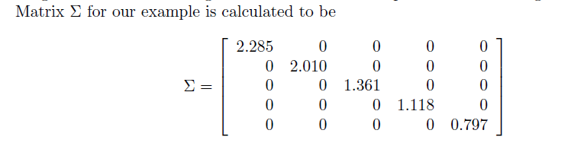
Perform an SVD on A using matrices B and C
where S is the matrix of the eigenvectors of B, U is the matrix of the eigenvectors of C, and ∑ is the diagonal matrix of the singular values obtained as square roots of the eigen values of B.
In LSI, ignore these small singular values and replace them by 0. Only keep k singular values in ∑

Slide 11



Thus reduce matrix ∑ into ∑_{k} which is an k ×k matrix containing only the k singular values, and also reduce S and U^{T} , into S_{k} and U_{k}^{T} , to have k columns and rows, respectively.
Matrix A is now approximated by
Where S_{k}, and U_{k}^{T} are m×k, k ×k, and k ×n matrices, their product, A_{k} is again an m × n matrix.
Intuitively, the k components of eigenvectors in S and U correspond to k “hidden concepts” where the terms and documents participate.
The new representation in terms of these hidden concepts.
The terms are represented by the row vectors of the m × k matrix
The documents by the column vectors the k × n matrix
The query is represented by the centroid of the vectors for its terms.

Slide 12


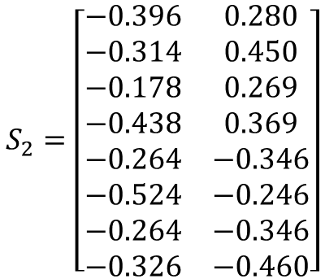
Suppose we set k = 2, i.e. consider only the first two singular values.
$$\begin{matrix}Saleem \\ anarkali \\ \begin{aligned}happy \\ gun \\ live \\ finishes \\ lavish \\ New−article\end{aligned} \end{matrix}$$
$$S_{2}=\left[\begin{matrix}−0.396 & 0.280 \\ −0.314 & 0.450 \\ −0.178 & 0.269 \\ −0.438 & 0.369 \\ −0.264 & −0.346 \\ −0.524 & −0.246 \\ −0.264 & −0.346 \\ −0.326 & −0.460\end{matrix}\right]$$
$$U_{2}^{T}=\left[\begin{matrix}−0.311 & −0.407 & −0.594 & −0.603 & −0.143 \\ 0.363 & 0.541 & 0.200 & −0.695 & −0.229\end{matrix}\right]$$
The terms in the concept space are represented by the row vectors of S₂ whereas the documents by the column vectors of U₂^{T} .
Represent the terms by the row vectors of S₂∑₂ and the documents by the column vectors of ∑₂U₂^{T}

Slide 13
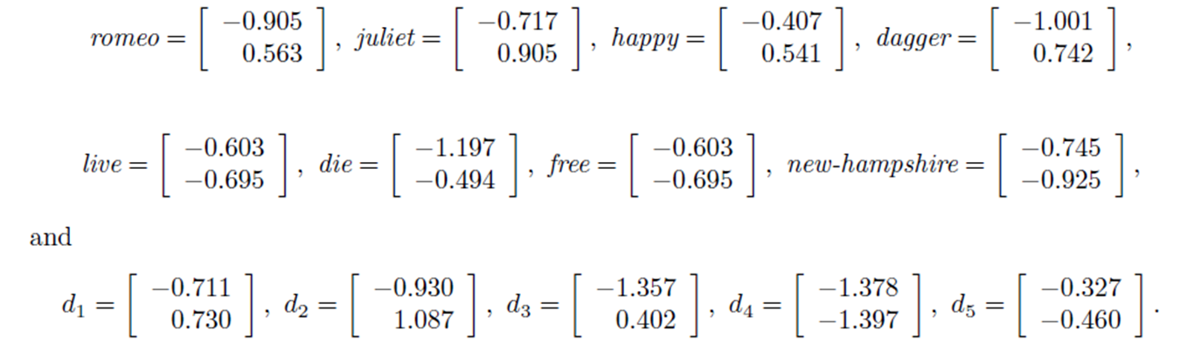
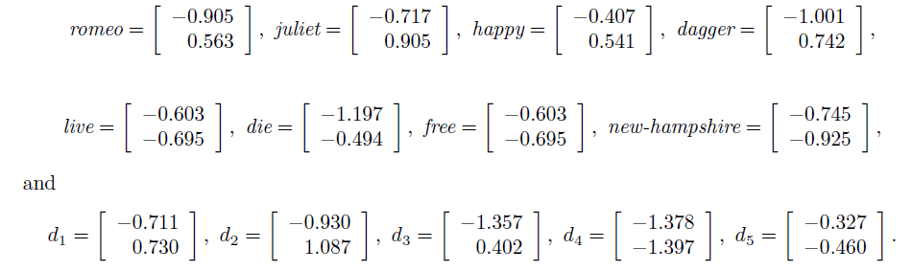




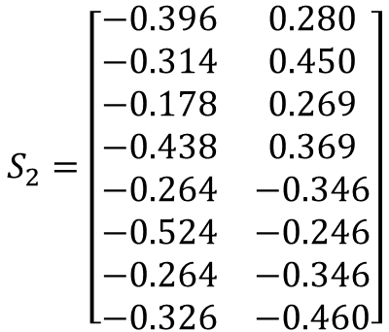



Represent the terms by the row vectors of S₂∑₂
$$S_{2}=\left[\begin{matrix}−0.396 & 0.280 \\ −0.314 & 0.450 \\ −0.178 & 0.269 \\ −0.438 & 0.369 \\ −0.264 & −0.346 \\ −0.524 & −0.246 \\ −0.264 & −0.346 \\ −0.326 & −0.460\end{matrix}\right]$$
$$Saleem$$
$$Anarkali=$$
$$gun$$
$$finish$$
$$lavish$$
$$New−article$$
Represent the documents by the column vectors of ∑₂U₂^{T}

Slide 14
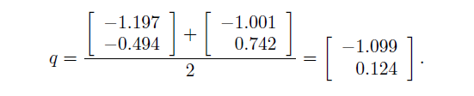

The query is represented by a vector computed as the centroid of the vectors for its terms.
In order to rank the documents in relation to query q, use the cosine distance.
where i ∈ [1, n] and then sort the results in descending order.

